Slide 1
Taxpayers’ Misperceptions and Two Novel Behavioral Interventions to Counter Tax Evasion
Dissertation Committee Members: Dr. Andrew Parker (chair), Dr. Raffaele Vardavas, Dr. Sebastian Linnemayr
Outside Reader: Dr. Kim Bloomquist
Doctoral fellow: Gursel Aliyev, Pardee RAND Graduate School
October 23rd, 2019

Slide 2
Nontrivial Scope of Tax Evasion in the US
The US Government is losing about $441 billion in unpaid taxes annually (IRS, 2019).
Roughly 60%-70% of our current federal budget deficit.
It is over three quarters of annual MEDICARE expenses.
Notes:
Roughly 60%-70% of our current federal budget deficit.

Slide 3
Background and Significance
Conventional interventions are audits and penalties.
However:
It is not practical to audit everyone: less than 1% of taxpayers are audited per year (IRS, 2018).
Audits are very costly: the IRS’s enforcement costs are around $4.7 billion per fiscal year (IRS, 2019).
They are not always successful in detecting tax evasion (Erard and Feinstein).

Slide 4
Focus and Objective of the Dissertation
Focus: Taxpayers’ perceptions about tax evasion and key elements of the U.S. federal tax system
Objective: Explore behavioral intervention opportunities to reduce tax evasion
Notes:
Punchline: Simple additions to the tax return form may potentially save billions every year.

Slide 5
Research Questions
How well do individual perceptions of audit rates, penalty rates and effective tax rates correspond to the actual audit, penalty and tax rates?
How do perceptions of audit rates, penalty rates and effective tax rates relate to tax evasion?
Using the answers to the questions above, what policy opportunities or policy elements are more likely to improve tax compliance?

Slide 6
Structure of the Proposed Dissertation
Chapter 1: Review of the Existing Literature Relevant to Tax Evasion
Chapter 2: Estimating Biases in Perception of Effective Tax Rates, Audit Rates and Penalty Rates
Chapter 3: Estimating Tax Evasion Elasticities with Respect to Perceived Audit, Penalty and Tax Rates
Chapter 4: Costly Misperceptions: Suggestions for Two Behavioral Interventions to Improve Tax Compliance

Slide 7
Structure of the Proposed Dissertation
Chapter 1: Review of the Existing Literature Relevant to Tax Evasion
Chapter 2: Estimating Biases in Perception of Effective Tax Rates, Audit Rates and Penalty Rates
Chapter 3: Estimating Tax Evasion Elasticities with Respect to Perceived Audit, Penalty and Tax Rates
Chapter 4: Costly Misperceptions: Suggestions for Two Behavioral Interventions to Improve Tax Compliance

Slide 8
Standard Economic Model of Tax Evasion: A dominant view on which the conventional tax compliance policies are based.
Taxpayers decide if and by how much they should evade taxes by maximizing their expected utility function, E[U]:
$$E\left[U\right]=\left(1−p\right)U\left(W−θX\right)+pU\left(W−θX−π\left(W−X\right)\right).$$
Where:
$p$ - is the probability that the taxpayer will be audited and the actual income $W$ will be known to the tax authority;
$X$ - is the declared income;
$θ$ - is the tax rate and;
$π$ - is the penalty rate.
(Allingham & Sandmo 1972)
Notes:
Comment: A-S paper was cited by 5,153.

Slide 9
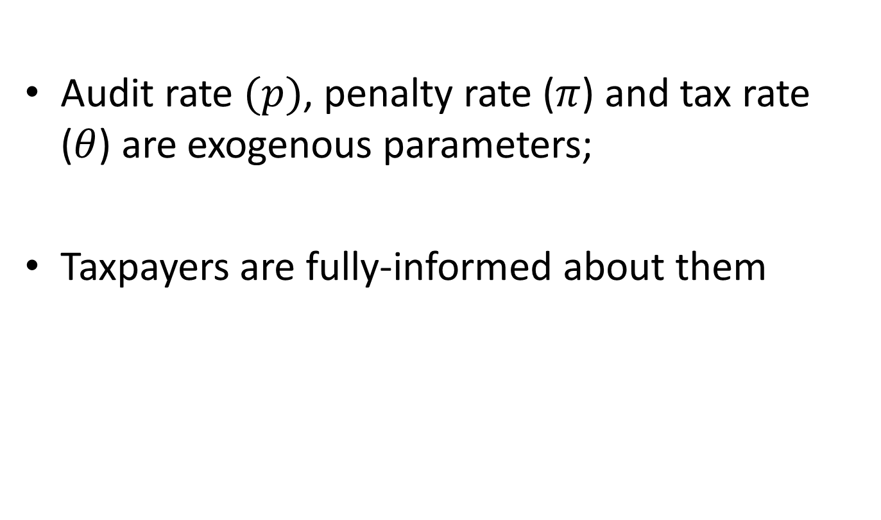
Key Assumptions of the Model:
Audit rate $(p)$, penalty rate ($π$) and tax rate ($θ$) are exogenous parameters;
Taxpayers are fully-informed about them

Slide 10
Structure of the Proposed Dissertation
Chapter 1: Review of the Existing Literature Relevant to Tax Evasion
Chapter 2: Estimating Biases in Perception of Effective Tax Rates, Audit Rates and Penalty Rates
Chapter 3: Estimating Tax Evasion Elasticities with Respect to Perceived Audit, Penalty and Tax Rates
Chapter 4: Costly Misperceptions: Suggestions for Two Behavioral Interventions to Improve Tax Compliance

Slide 11
Data
Publicly available IRS data on the tax gap, actual (realized) audit, penalty and tax rates.
The American Life Panel (ALP) Tax Evasion Survey (ms456) data (n = 1029 respondents).
Notes:
Discuss ALP Tax Evasion Survey. Hand out Table 9.

Slide 12
Main Variables of Interest from the ALP Tax Evasion Survey:
Evasion Rates: In a typical year, out of 100 people like you, how many intentionally underreport their taxes?
Perceived Effective Tax Rates: What do you think your effective [federal] income tax rate was this past year?
Perceived Audit Rate: In a typical year, what percent of taxpayers in the U.S. will have their income tax return audited by the IRS?
Perceived Penalty Rate: Imagine a person was caught underpaying their taxes by $1000. In addition to having to pay that $1000, how much of a penalty would they have to pay?
Notes:
Mention that the data was collected for the Tax Evasion Survey. Clickable scales.

Slide 13
People Mostly Overestimate Their Tax Rates
Only an estimated 14% of the population perceive their effective tax rate to be within 5 percentage points of their actual tax rate.
While the median of the estimated actual effective tax rate is 8.1%, the median perceived effective tax rate is 25%.
Notes:
US estimated median for the effective tax rate is 4.8%.

Slide 14
Plausible Explanations for the Overestimation of the Tax Rates
People conflate federal taxes with state and other taxes
“Over-claiming” – individuals tend to overestimate their relative contribution to their collective work (Kruger & Savitsky, 2009; Ross & Sicoly, 1979; Caruso et al., 2006; Schroeder et al. 2016)
Taxes may loom larger because of loss aversion
Confusing effective tax rates with marginal tax rates (no evidence)

Slide 15
People Mostly Underestimate the Penalties
The median perceived penalty rate among the US population is estimated to be 20%, which is well below the fraud penalty rate of 75%.
The most common (modal) perception about the penalty rate is 10% (about 26% of the population).

Slide 16
Plausible Explanations for the Underestimation of the Penalty Rate
Complex penalty system and multiple types of penalties
Probabilistic nature of the penalties
Limited experience with penalties

Slide 17
Structure of the Proposed Dissertation
Chapter 1: Review of the Existing Literature Relevant to Tax Evasion
Chapter 2: Estimating Biases in Perception of Effective Tax Rates, Audit Rates and Penalty Rates
Chapter 3: Estimating Tax Evasion Elasticities with Respect to Perceived Audit, Penalty and Tax Rates
Chapter 4: Costly Misperceptions: Suggestions for Two Behavioral Interventions to Improve Tax Compliance

Slide 18
Two Main Models of the Evasion Rates:
Mixed-Effects and Fractional Response Models
Selection Criteria:
Relative simplicity, and ease interpreting the results.
Better quality measured in Akaike Information Criterion (AIC) and Bayesian Information Criterion (BIC) values.
Some theoretical basis and/or a methodological precedent of using a similar model in similar circumstances.

Slide 19
The Regression Models of the Evasion Rate
Independent Variables | Mixed-Effects Model |  | Fractional Response Model
 | Coef. | p-values | Coef. | p-values | Average Marginal Effects
Perceived Rates and the Group Assignment:
Tax rate | 0.308 | <0.001 | 0.665 | 0.040 | 0.134
randomtaxincrease | -0.022 | 0.325 | 0.028 | 0.856 | 0.033
randomtaxincrease*Tax rate | 0.230 | 0.003 | 0.432 | 0.279 | 0.106
Audit rate | -0.046 | 0.045 | 0.115 | 0.484 | 0.024
Penalty rate | -0.070 | 0.003 | -0.011 | 0.230 | -0.002
Personal Characteristic:
… | … | … | … | ... | …
Social Network Characteristics:
… | … | … | … | … | …
Experiences:
… | … | … | … | … | …
Attitudes, beliefs, and views:
… | … | … | … | … | …
 | N = 5,159; Resp. = 752; Wald chi2(30) = 285.08 |  | N = 5,084; Resp. = 741; Wald chi2(29) = 210.44
Estimates
Covariates
Notes:
Evasion Rates: In a typical year, out of 100 people like you, how many intentionally underreport their taxes?

Slide 20
Other Covariates: Personal and Social Network Characteristics
Covariates | Description
Personal Characteristics:
Age | in years
Black-African American | = 1 if Black-African American; 0 otherwise
Native American | = 1 if Native American; 0 otherwise
Asian | = 1 if Asian; 0 otherwise
Other Race | = 1 if Other race; 0 otherwise
hispaniclatino | = 1 if Hispanic/Latino; 0 otherwise
male | = 1 if male; 0 otherwise
married | = 1 if married; 0 otherwise
education | = 1 if has Bachelor's degree and above; 0 otherwise
foreignborn | = 1 if foreign born; 0 otherwise
Marginal Tax Rate | Marginal tax rate estimated based on the survey questions on family income. Measured in fractions, i.e., range [0;1]
Estimated Tax Rate | Effective tax rate estimated based on the survey questions on family income. Measured in fractions, i.e., range [0;1]
selfemployed | = 1 if self-employed; 0 otherwise
Social Network Characteristics:
prop_altersaudited | Proportion of alters who are believed to be audited
prop_alters_talkTaxes | Proportion of alters with whom the respondent has talked or consulted with about taxes in the past 5 years
prop_alterselfemployed | Proportion of alters who are self-employed

Slide 21
Other Covariates: Experiences with the Tax System, Attitudes, Beliefs, and Views
Covariates | Description
Experiences:
hheveraudited | = 1 if self or spouse has ever been audited; 0 otherwise
haventfiledtaxes | = 1 if ever filed taxes or had someone else to file taxes for them; 0 otherwise
preptaxesself | = 1 if prepares taxes himself/herself; 0 otherwise
Attitudes, beliefs, and views:
pcaught | Respondents’ subjective probability of being caught if a taxpayer underreports taxes
prob_deduction | Respondents’ subjective probability of them claiming a questionable tax deduction
actor_more | = 1 more likely or somewhat more likely to fully report taxes if a famous actor is known to evade taxes; 0 otherwise.
freeriding_never | Total number of "Never ok" responses to 5 separate questions about engaging in 5 different free-riding activities. Maximum is 5 (it is never ok to engage in all these free-riding activities); minimum is 0 (the respondent thinks that it is always ok or sometimes ok to engage in all these 5 free-riding activities). These free-riding activities are: 1. Regularly listen to public radio without ever contributing; 2. Illegally copying, downloading, or streaming movies; 3. Have a dog but not getting it spayed or neutered; 4. Avoid getting the flue vaccine; 5. Avoid paying all of the income tax that you owe.
freeriding_percentage | Average score for 5 questions about percentage of people like respondents who engage in 5 different free-riding activities. These free-riding activities are the same as described in the entry for freeriding_never.
worthpayingtaxes | = 1 if thinks that public goods and services worth paying taxes for; 0 otherwise
importancetaxbenefits | Relative importance of benefits and public service supported by taxes when the respondent thinks about taxes and paying his/her taxes. Maximum is 100 points; more points more important.
importancemoraloblig | Relative importance of a moral obligation to correctly report and pay taxes when the respondent thinks about taxes and paying his/her taxes. Maximum is 100 points; more points more important.

Slide 22
Structure of the Proposed Dissertation
Chapter 1: Review of the Existing Literature Relevant to Tax Evasion
Chapter 2: Estimating Biases in Perception of Effective Tax Rates, Audit Rates and Penalty Rates
Chapter 3: Estimating Tax Evasion Elasticities with Respect to Perceived Audit, Penalty and Tax Rates
Chapter 4: Costly Misperceptions: Suggestions for Two Behavioral Interventions to Improve Tax Compliance

Slide 23
Key Findings Providing Rationale for the Proposed Behavioral Interventions:
People have considerable misperceptions about their effective federal income tax rates and the penalties for underreporting taxes.
There is evidence suggesting that these misperceptions may exacerbate tax evasion.

Slide 24
There Are Opportunities for Behavioral Interventions
And the questions are:
What low-cost, modest-reward interventions could we envision?
What evidence do we have about the expected benefits of such interventions?

Slide 25
Intervention 1: Correcting Taxpayers Misperceptions About Their Effective Tax Rates
Adding a line for the effective tax rate on Form 1040 with an explanatory note like:
“Your effective tax rate is X%, which means that you pay X cents as federal taxes per each dollar that you make”

Slide 26
Part of the 2nd Page from Form 1040

Slide 27
Applying the Main Principles of the EAST Framework to Intervention 1:
Make It Easy: The effective tax rate can be automatically calculated in the electronic returns.
Make It Attractive: The new line and the explanatory note accompanying it can be highlighted by using different colors, fonts and designs.
Notes:
Stress that this framework was developed by the UK’s Behavioral Insights to help policymakers use insights from behavioral science to tackle various policy problems. Stress that it is about how the interventions should be implemented to make them more effective.

Slide 28
Applying the Main Principles of the EAST Framework to Intervention 1 (cont’d):
Make It Social: An additional short statement may be added next to the line to emphasize social aspect of taxes, e.g., “Most people overestimate their tax rate when in reality it is quite low” or “Paying taxes means we all gain from vital public services like national defense, roads, and schools.”
Make It Timely: The effective tax rate should be shown during the filing process (e.g., right after line 15 for the total tax in Form 1040).

Slide 29
How Would Intervention 1 Work?
Tax evaders moderating their underreporting to avoid “suspiciously low” tax rates.
Less negative attitudes toward taxes and increased willingness to pay taxes.

Slide 30
Intervention 2: Increasing the Salience of Penalties
Adding a message about the penalty rate in Form 1040:
“If there is any underpayment on your tax return due to fraud, a penalty of 75% of the underpayment will be added to your tax. You may also be subject to criminal prosecution and imprisonment.”
or
“Any underpayment of taxes due to fraud is punishable by an additional penalty of 75% of the underpayment. You may also be subject to criminal prosecution and imprisonment.”

Slide 31

Applying the Main Principles of the EAST Framework to Intervention 2:
Make It Easy: Accessible language should be used to make the penalty message easy to read and understand.
Make It Attractive: To highlight the message, different format, fonts and colors can be used, e.g.:
WARNING!: If there is any underpayment on your tax return due to fraud, a penalty of 75% of the underpayment will be added to your tax. You may also be subject to criminal prosecution and imprisonment.

Slide 32
Applying the Main Principles of the EAST Framework to Intervention 2 (cont’d):
Make It Social: The penalty message can be followed by a social norm statement like: “The vast majority of Americans fully pay their federal taxes.”
Make It Timely: Ideally, it would be good to present the penalty message immediately before taxpayers decide about underreporting taxes.

Slide 33
Including the Penalty Message on the 1st Page of Form 1040
The penalty message can be placed somewhere here.

Slide 34
How Would Intervention 2 Work?
It would discourage taxpayers from underreporting their taxes by:
Correcting misperceptions about the penalties that they are low and better calibrating the perceived costs of evading;
Increasing the salience of the penalties at the time when taxpayers usually make decision whether to evade taxes or not.

Slide 35
Potential Effects of the Proposed Interventions on the Evasion Rate Among Taxpayers Who Prepare Their Tax Returns Themselves (Assuming 100% Effectiveness in Correcting the Misperceptions)
 | No intervention | Intervention 1 only | Intervention 2 only | Both Interventions
Predicted Evasion Rates | 22.22% | 19.72% | 22.07% | 19.57%
Reduction in Evasion Rates (in percentage points) | -- | 2.50 | 0.15 | 2.65
Link to the models
Notes:
A fractional response model was used to estimate the evasion rates.
100% effectiveness is not realistic, but making this assumptions: 1) simplifies calculations; 2) helps to estimate the upper bound of the effects. It can easily be relaxed though.

Slide 36
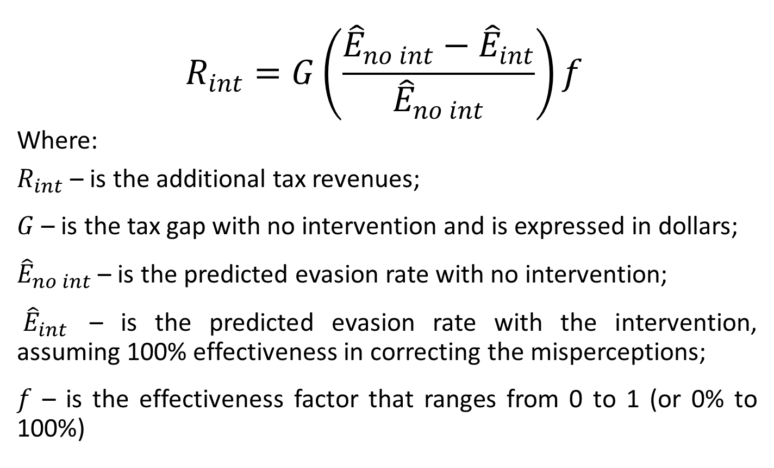
Formula to Estimate Additional Tax Revenues That Could Be Collected Due to the Interventions
$$R_{int}=G\left(\frac{{\hat{E}}_{no int}−{\hat{E}}_{int}}{{\hat{E}}_{no int}}\right)f$$
Where:
$R_{int}$ – is the additional tax revenues;
$G$ – is the tax gap with no intervention and is expressed in dollars;
${\hat{E}}_{no int}$ – is the predicted evasion rate with no intervention;
${\hat{E}}_{int}$ – is the predicted evasion rate with the intervention, assuming 100% effectiveness in correcting the misperceptions;
$f$ – is the effectiveness factor that ranges from 0 to 1 (or 0% to 100%)
Notes:
G is estimated to be $113.925 billion.

Slide 37
Additional Tax Revenues That Could Be Collected Due to the Interventions at Different Levels of the Intervention Effectiveness (i.e., f)
The Intervention Effectiveness Factor, (f) | Additional Tax Revenues (in billions of dollars)
 | Intervention 1 only | Intervention 2 only | Both Interventions
100% | 12.83 | 0.81 | 13.60
80% | 10.27 | 0.65 | 10.88
60% | 7.70 | 0.49 | 8.16
40% | 5.13 | 0.33 | 5.44
20% | 2.57 | 0.16 | 2.72
10% | 1.28 | 0.08 | 1.36
Notes:
For comparison the IRS budget is $11.2 billion. Mention future research on the effectiveness.

Slide 38
Some Potential Costs of the Proposed Interventions
Monetized taxpayers’ additional filing time burden:
0.05 hours of additional time* $28 per hour (average hourly earnings)* 152.9 million individual income tax returns = $214 million
Costs of a randomized field experiment to obtain more reliable estimates of the impact
Implementation costs
Notes:
One-time costs, recurring costs.

Slide 39
Key Discussion Points:
The costs of the proposed interventions could be sizable.
However, the potential benefits could substantially outweighed the costs.
Potential benefits could be higher if more people prepare their tax returns themselves.
While the suggested interventions are promising, they would not solve tax evasion completely.

Slide 40
Limitations
The effects of the interventions were estimated primarily with self-reported data
The results also depend on how well the regression model used in the analysis depict the actual relationship between the perceived tax rate, the perceived penalty rate and tax evasion.
No spillover effects or effects over years were considered.
No potential interaction effects between the interventions were considered.
No total cost estimates were provided.

Slide 41
Acknowledgement:
The Anne and James Rothenberg Dissertation Award
The Jeremy R. Azrael Scholarship
The National Science Foundation’s Interdisciplinary Behavioral and Social Science Research program (Award Number 1519116)

Slide 42
Thank You!

